Slide 1


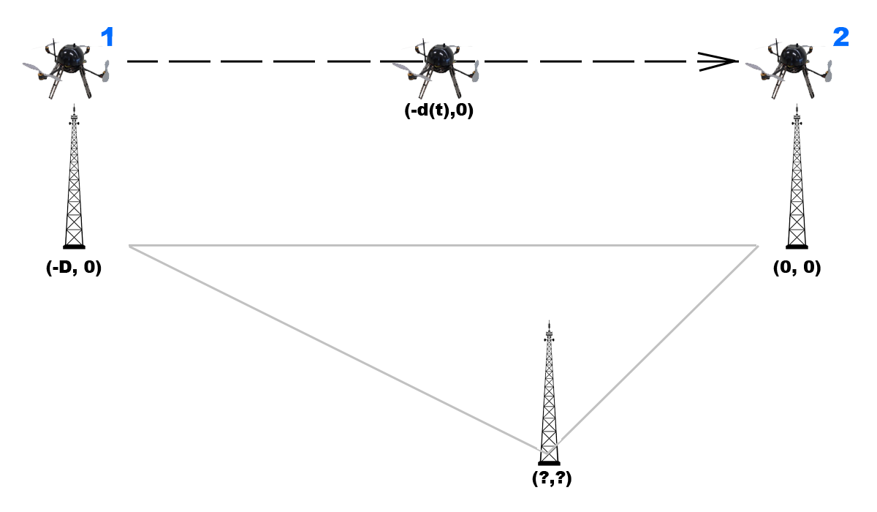
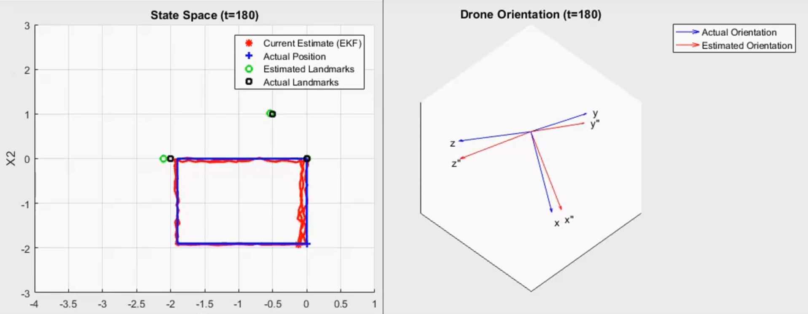
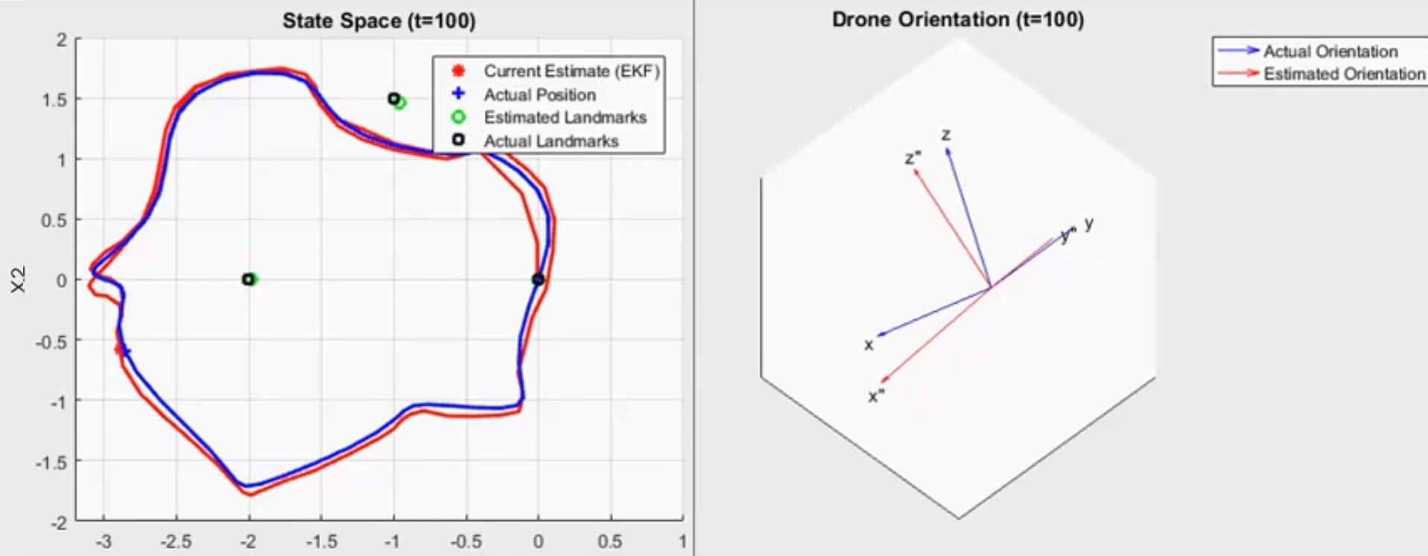
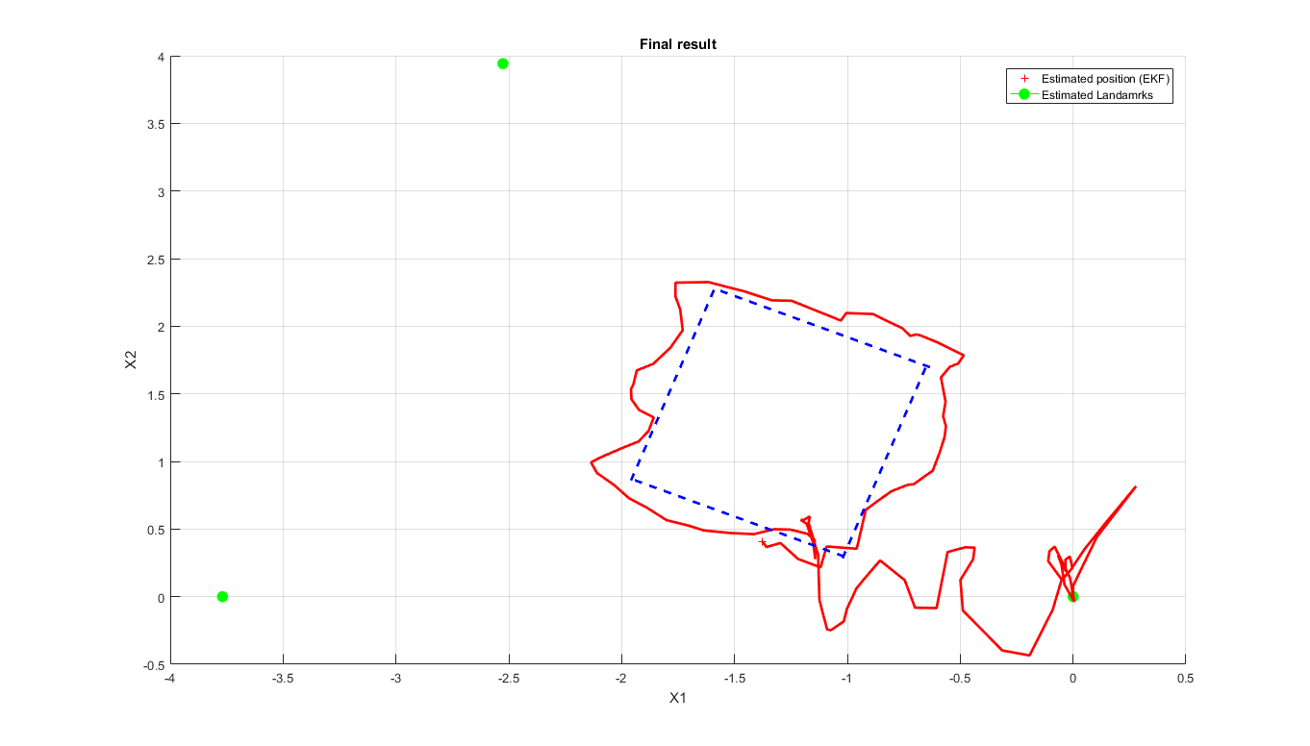
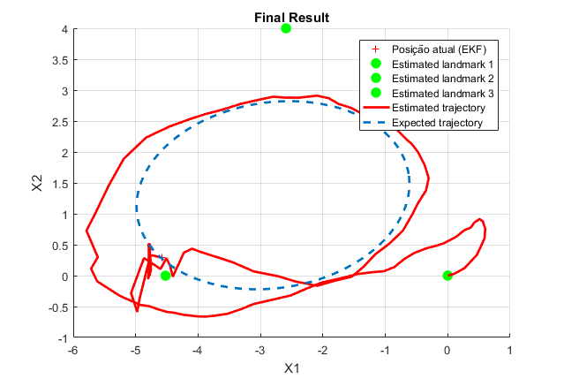
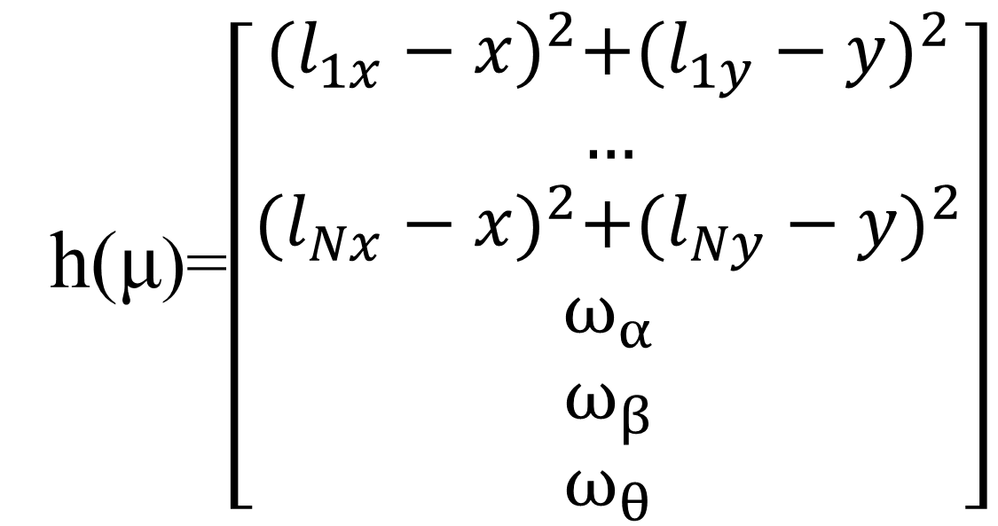
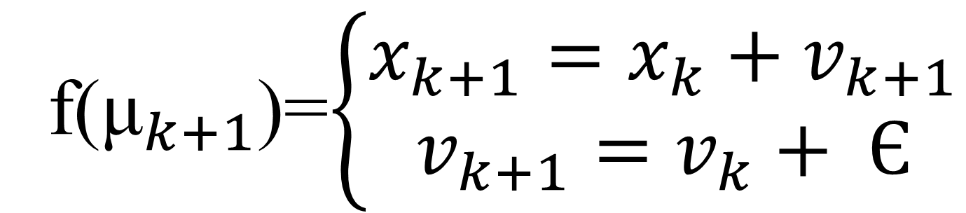
Sistemas Autónomos / Autonomous Systems
Drone SLAM with Extended Kalman Filter using UWB sensors and a IMU,
Afonso Luís, José Silva, Samuel Amaro, Tiago Silva
afonso.lopes.luis@tecnico.ulisboa.pt , j.ferreira.da.silva@tecnico.ulisboa.pt,
samuel.amaro@tecnico.ulisboa.pt, tiagorsilva@tecnico.ulisboa.pt
MEEC
Instituto Superior Técnico, Universidade de Lisboa
1 - KALMAN FILTER / EKF
3.3 - INITIALIZATION
The Kalman filter is an algorithm that uses a series of measurements of a linear system over time and produces estimates of unknown variables that tend to be more accurate than those based on a single measurement. The algorithm is a two step process, the prediction step and the update step. For non-linear systems the same principle can be used in the form of the Extended Kalman Filter.
Since a solid initialization is crucial for the EKF’s performance, a method based on Least Squares was developed. In this the drone must travel from a LM forced to be at (-D,0) to another landmark forced to be at (0,0), where D is the distance between these two.
2- VEHICLE AND SENSORS
Drone: Parallel movement to the ground with no sudden movement changes;
Ultra-Wide Band: Measures de distance between the tag (Drone) and anchors (landmarks);
Inertial Measurement Unit: Measures the unit’s angular rate in all 3 rotational axis.
4 - SIMULATION
3- IMPLEMENTATION
3.1 – MOTION MODEL
The Drone does not provide any odometry readings, also the UM readings are too noisy to consider using dead reckoning for the position estimates. Other than these 2 there are no more available measurements that can be used for the prediction of the Drone's movement. Therefore a first order motion model was used for the part, given by
f(${\text{μ}}_{k+1}$)=$\left\{\begin{aligned}x_{k+1}=x_{k}+v_{k+1} \\ v_{k+1}=v_{k}+ Є\end{aligned}\right.$
3.2 – OBSERVATION MODEL
From the 2 available system observations (UWB and IMU) the first ones will be used to correct the prediction of both Drone and Landmark predictions through the by squaring the read distances. The IMU readings are used to correct the prediction of the Drone’s pose. This can be modeled as
5- REAL DATA
h($\text{μ}$)=$\left[\begin{matrix}{(l_{1x}−x)}^{2}+{(l_{1y}−y)}^{2} \\ … \\ {(l_{Nx}−x)}^{2}+{(l_{Ny}−y)}^{2} \\ ω_{α} \\ ω_{β} \\ ω_{θ}\end{matrix}\right]$
https://github.com/silvaordie/Projeto-SA
© 2018 Autonomous Systems / DEEC / IST

